Slide 1
Ancient Civilizations
Aztec, Inca, and Maya

Slide 2
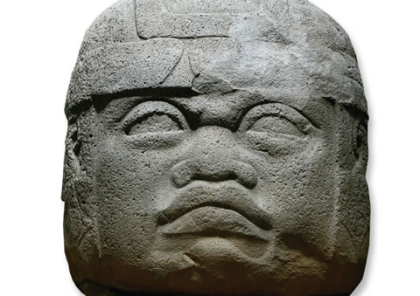

Slide 3
OLMEC HEAD
Several stone heads like this one have been found in the Olmec heartland in Mexico’s Gulf Coast region. They may represent rulers or important people.

Slide 4
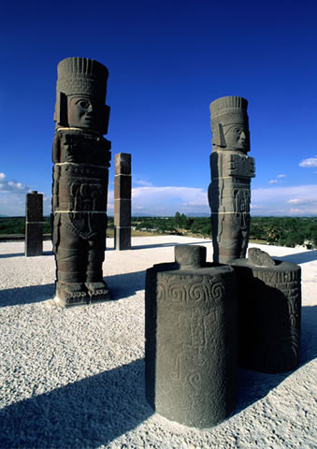

Slide 5
TOLTEC WARRIOR
The Toltec capital of Tula reflects the beginning of an era of great military action. The site is full of carvings of warriors equipped for war, including these that once supported a roof.

Slide 7
INCAN BATHS
These Incan baths at Tambomachay, near Cuzco, were built at the site of a sacred spring. Water ran along stone channels into the baths, which were used by Incan kings.

Slide 8
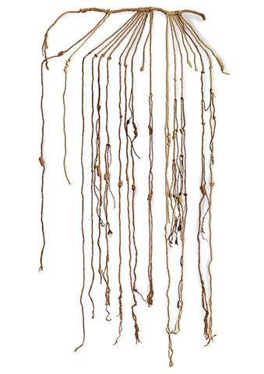
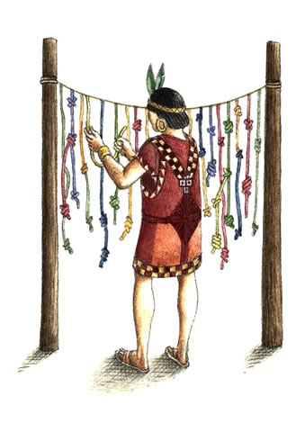

Slide 9
INCAN QUIPU
The Incas stockpiled goods to be used by government officials. These stored goods were recorded on a quipu, a counting device consisting of variously knotted strings.

Slide 10
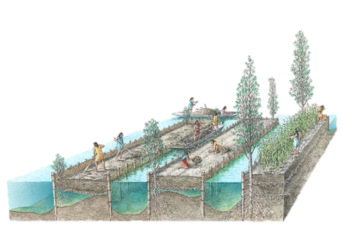

Slide 11
CHINAMPAS
The Aztecs grew their most productive crops on the chinampas, plots of fertile land built up in rectangular strips in marshy lakes

Slide 13
AZTEC HOME
The Aztecs lived in simple adobe (mud) houses, often containing only one main room and very little in the way of furniture

Slide 14
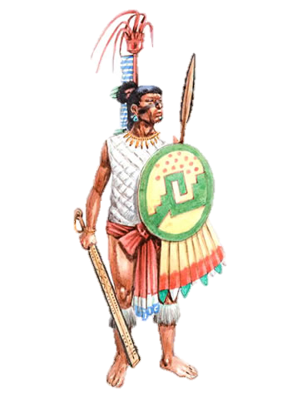

Slide 15
AZTEC APPRENTICE WARRIOR
In Mesoamerica, youths had to join the army at the age of 17. Showing courage in battle was the best and most common way of climbing the social ladder.

Slide 17
JAGUAR WARRIORS
The most prestigious military orders were those of the eagle and the jaguar, each of which had its own special warrior costume.

Slide 18
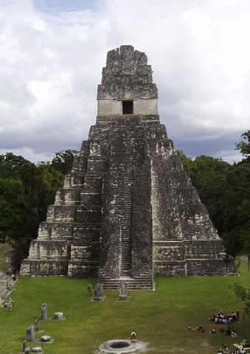

Slide 19
TEMPLE OF THE GIANT JAGUAR
This majestic temple stands in the ceremonial center of the Mayan city of Tikal.

Slide 20
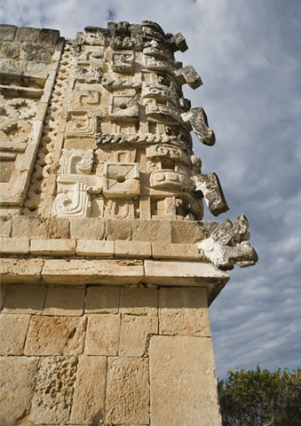

Slide 21
RAIN GOD
The Mayan god of rain was named Chac. In some regions, he was so important that the facades of buildings were covered with his masks.

Slide 22
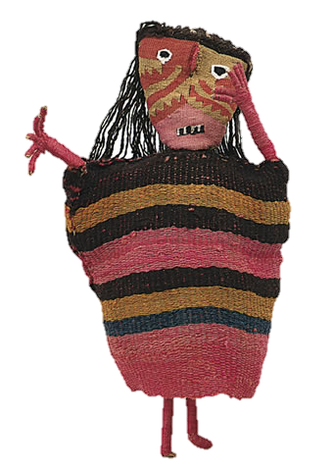

Slide 23
DOLL COMPANION
These colorful figures found in Chancay tombs are called “dolls” because it is believed they were used in daily life. They were placed with the deceased to serve them in the afterlife.

Slide 24
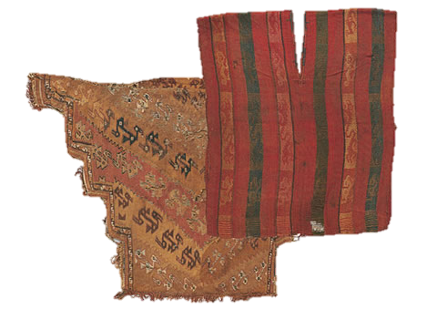
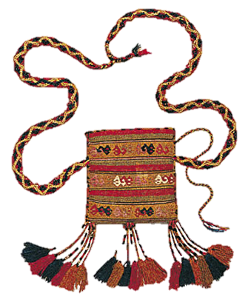

Slide 25
PONCHOS and PERUVIAN BAG
Tunics and ponchos could be highly decorative. They were worn slipped over the head and were sewn at the sides
All Peruvian men carried a small bag under their cloak, slung over the shoulder. In it they carried coca leaves for chewing and amulets (good-luck charms).

Slide 26
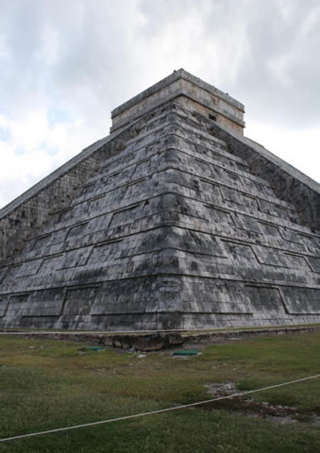

Slide 27
EL CASTILLO
Dominated by the temple-pyramid El Castillo (The Castle), the Mayan city of Chichen Itza grew into an important commercial center with links to many other areas.

Slide 28
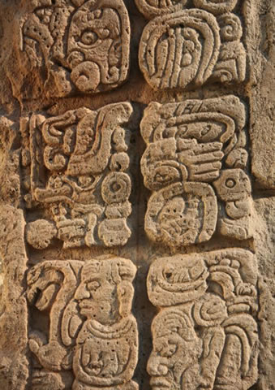

Slide 29
MAYAN GLYPHS
Mayan inscriptions were mainly historical, recording births, accessions, wars, deaths, and marriages of Mayan kings.

Slide 30
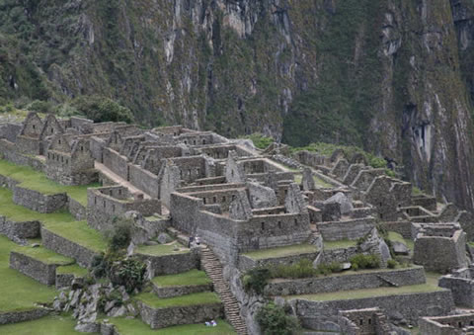

Slide 31
MACHU PICCHU
Spanish conquistadores never found the remote city of Machu Picchu, strategically positioned at the edge of the Incan Empire. Although known locally, it was unknown to the outside world until 1911.

Slide 32
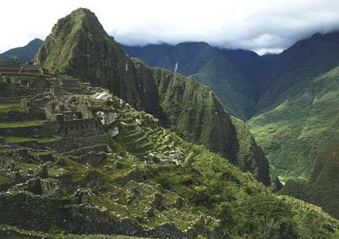

Slide 33
MACHU PICCHU TERRACES
To get the highest yield from their crops,
the Incas used sophisticated terracing
and irrigation methods on hillsides.
Terracing also resists land erosion.

